Slide 1


Marathwada Mitra mandal’s
COLLEGE OF ENGINEERING
Karvenagar, Pune
An Autonomous Institute
Presentation
On
PROJECT:-
GPS TRACKING

Slide 2
Group Information
MEMBERS
Sr.No | Prn No | Name of students
1 | B24IT1130 | Shreyash Mandlapure
2 | B24IT1054 | Gaurav Jadhav
3 | B24IT1040 | Vinit Patil
4 | B24IT1044 | Sarthak Patil

Slide 3
Outline:
Introduction
Research
Analysis
Ideate
Build
Test
Implement
Links
Reference

Slide 4
Introduction
Combines Embedded C programming with the ESP8266 microcontroller for efficient real-time GPS tracking.
Captures GPS coordinates and provides continuous location updates.
Transmits data over Wi-fi to a server, displayed on Google Maps via a dynamic URL.
Offers a simple, reliable, and real-time solution for location tracking.
Applications
Fleet Management: Track and monitor vehicles in real-time.
Asset Monitoring: Secure and track valuable equipment or containers.
Personal Safety: Enhance safety in hazardous environments or emergencies.

Slide 5
Introduction
Key Components and Functionality
ESP8266 Microcontroller: Manages Wi-Fi connectivity and data transmission.
NEO 6M GPS Module: Captures GPS coordinates (latitude & longitude).
TinyGPS++ Library: Decodes GPS data for accurate real-time updates.
Google Maps Integration: Displays location via a dynamically generated URL.
Wi-Fi Network: Ensures seamless communication between the system and the server.

Slide 6
B. Research
This project focuses on creating a cost-effective, real-time GPS tracking system using widely available components like the ESP8266 microcontroller and NEO 6M GPS module.
Secondary Research:
Existing Systems: Popular GPS trackers such as Garmin offer advanced features but are costly and complex for general users.
Market Gaps: Identified a need for affordable and easy-to-use solutions for personal safety, asset monitoring, and fleet management.
Primary Research:
Conducted field tests using the NEO 6M GPS module under different conditions (urban vs. rural environments) to observe data accuracy.
User interviews revealed interest in features like live tracking on Google Maps and geofencing notifications.

Slide 7
C. Analysis
Analyzing the problem space involved understanding the limitations of existing solutions and identifying user pain points.
Challenges:
Signal interference indoors or in obstructed areas.
Maintaining stable Wi-Fi connectivity.
Formatting GPS data for user-friendly display.
Visualization:
Created user personas: A logistics manager monitoring fleet vehicles, a solo traveler ensuring safety, and a homeowner tracking assets.
Developed journey maps for scenarios like live tracking, ensuring seamless interaction between the GPS module, ESP8266, and the Google Maps interface.

Slide 8
D.Ideate
Brainstorming and creativity techniques led to innovative solutions:
Explored various output formats, such as dynamic URLs and app-based notifications.
Proposed alternative implementations like SMS-based location sharing for areas with limited internet access.
Used mind maps to design features like geofencing and power-saving modes.
Algorithm of the program :
S1) START
S2) CONNECT TO WIFI NETWORK
S3) CONNECTED TO WIFI NETWORK
S4) GET LATITUDE AND LONGITUDE FROM GPS MODULE
S5) INPUT THE DATA TO MICROCONTROLLER
S6) GENERATE A URL LINK FOR GOOGLE MAPS USING THE LATITUDE AND LONGITUDE
S7) PASTE THE LINK ON THE BROWSER
S8) END

Slide 9
Pseudocode of the program :
START
Step 2: Connect to Wi-Fi network
CONNECT_TO_WIFI()
Step 3: Check if connected to Wi-Fi network
IF WIFI_CONNECTED THEN
PRINT "CONNECTED TO WIFI NETWORK"
Step 4: Get latitude and longitude from GPS module
latitude, longitude = GET_GPS_COORDINATES()
Step 5: Input the data (latitude and longitude) to the microcontroller
SEND_TO_MICROCONTROLLER(latitude, longitude)
Step 6: Generate a URL link for Google Maps using latitude and longitude
google_maps_link = "https://www.google.com/maps?q=" + latitude + "," + longitude
Step 7: Paste the link on the browser
OPEN_BROWSER(google_maps_link)
END

Slide 10
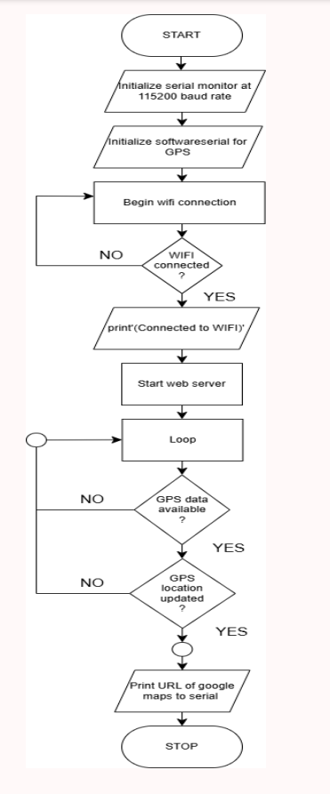
Flowchart of the program :

Slide 11
E. Build
This phase focused on developing the system and creating prototypes:
Soft Designed a flowchart to visualize the data flow from the GPS module to the user interface.
Hard Prototyping:
Created a circuit diagram showing the NEO 6M GPS module connected to ESP8266 via the SoftwareSerial interface.
System architecture included Wi-Fi connectivity for data transmission and URL generation.

Slide 12
F.Test
Extensive testing ensured functionality and reliability:
Test Cases:
Verify GPS data transmission when the signal is weak.
Test URL generation for incorrect latitude/longitude inputs.
Check latency in live updates over varying Wi-Fi speeds.
Feedback: Users reported occasional delays in URL generation in low-signal areas. This was resolved by optimizing data processing code.

Slide 13
G.Implement
Software Requirement
Hardware Requirement
Programming Approach Used (ex.array, union,file handling)

Slide 14
H. Links
1.Youtube link(Presentation Video) : https://www.youtube.com/watch?v=T0E12_eBaEY
2.Blog link :
https://gpstrackingproject.blogspot.com/2024/11/real-time-gps-tracking-system.html
3. Github link :
https://github.com/OtakuNoDev/GPS_project

Slide 15
Reference
https://circuitdigest.com/microcontroller-projects/interfacing-neo6m-gps-module-with-esp32

